Slide 1




Council
4 permanent members
4 members to be elected by assembly
Met 4 times a year
Political problems / disputes
Decisions to be unanimous ( right to veto )
Assembly
3 members from every country
all members had equal votes
made decisions affecting world peace
Decisions to be unanimous ( right to veto )
Met annually.
Secretariat
Permanent staff
Head quarters – Geneva
Kept records of meetings and discussions.
Court of International justice
Set up in the Netherlands 1922
15 judges from various countries
Deal with international disputes
Could not force countries to accept there decisions
From 1922-39 it settled 70 cases & helped arrange 400 international agreements.
Special commissions
Deal with specific problems e.g.. Drugs commission minorities commission ect.
Much of successful work took place here.
Committees
Social economic & humanitarian matters Included health, financial and economic organisation
special comities for drug traffic, women's rights, refugees, child welfare . Eg .ILO To improve living and working conditions Agreements on working hours working conditions & the right to belong to a trade Union.

Slide 2
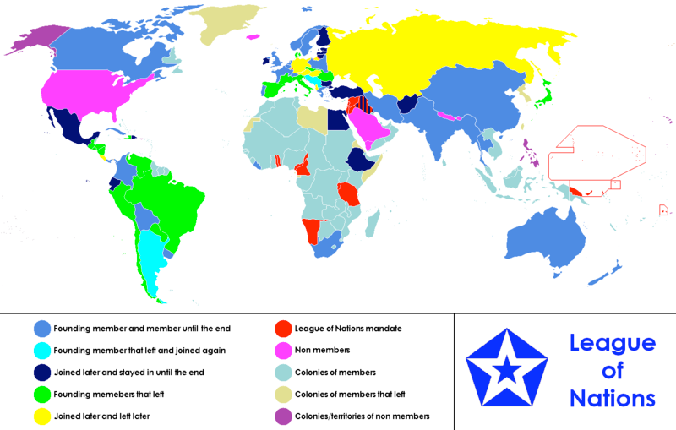
Including : England, France, Canada, Australia, India, China
Including : Argentina , Yugoslavia
Including : Mexico Egypt Ethiopia Ireland , Afghanistan Iraq Bulgaria Finland , Estonia, Ecuador
Including : brazil , Peru, Venezuela , Japan Spain , Italy , Romania

Slide 3
Strengths | Weaknesses
42 countries were members rising to 58 in 1934 Set up the council which met four to five times a year and in times of crisis Allowed the League to respond quickly to crises. collective security made it safer and less likely for a war to break out Britain and France were the main members, helped by Italy and Japan; they were quite powerful countries. | The USA, USSR and Germany - the three greatest powers in the world - were not members. agreements of the assembly and council had to be unanimous Made it very hard to get anything done Set up the Secretariat. Too small to handle the vast work of the League . If someone declared war on a country it couldn’t be stopped because of the right to veto . They did not have an army. One of the biggest weaknesses was that the League’s organisation was in a muddle. The different parts of the League were supposed to act together; but in a crisis, no-one could agree.
Both Sides Set up by the Treaty of Versailles and agreed by everybody at the conference.

